Slide 1
New York Taxi
Big data project
Kaggle

Slide 2
Project by
Menna Mustafa

Slide 3
“Time is what we want most, but what we use worst”
—William Penn

Slide 4
Problem
How long is your trip?
If you are going to a new place, when will you leave home?
Let’s discover new place!
Is it safe?
It’s weekend, let’s hangout!
What about the congestion?!

Slide 5
Business
Target users
Customers
Get an estimate for their taxi trips time duration
Congestions avoidance
Check safety of a place
New York Government
Investigate the problem of highly congested places
Investigate the problem of high risk places
Taxi vendors
Know when and where is the peak of taxi trips requests.

Slide 6






“Let’s talk data!”
Taxi trips
Machine learning
&
Analytics
Trip duration
Fastest routes
Congestion analysis
Risk score
Accidents
- As of 2016

Slide 7





Project pipeline “if we torture the data long enough it will confess”
1
2
3
4
5
Understand domain knowledge
Data understanding, cleansing and validation
Data exploration and preparation
Model selection and building
Testing and results

Slide 8
Congestion analysis
Features
Streets that routes pass through
Data and time for trip in each route
Objective
What are the top 10 congested streets in NYC?
When are they mostly congested? (Peak hour, peak day)

Slide 9
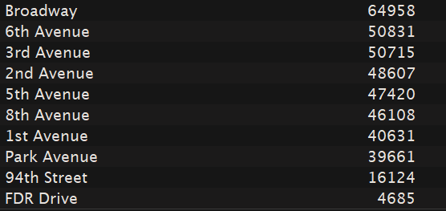
Top 10
streets

Slide 10
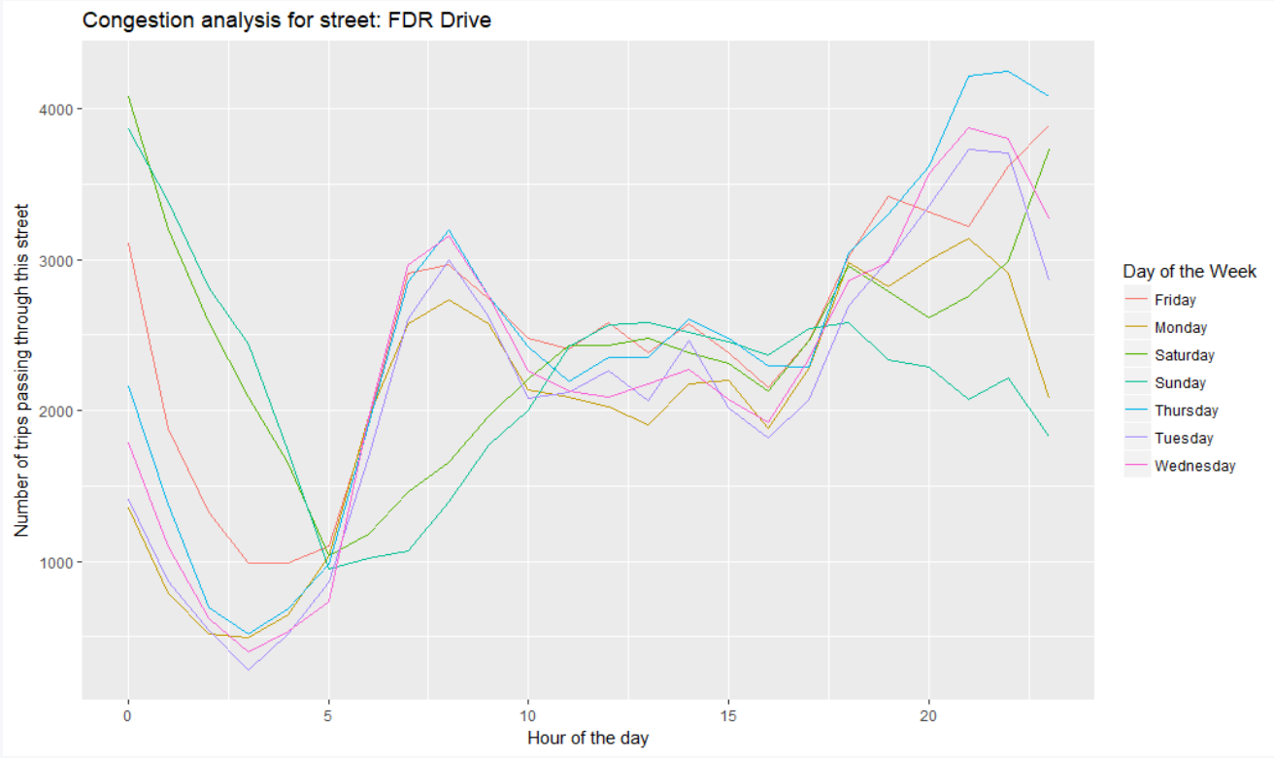
Results
For each one of the top 10 streets

Slide 11
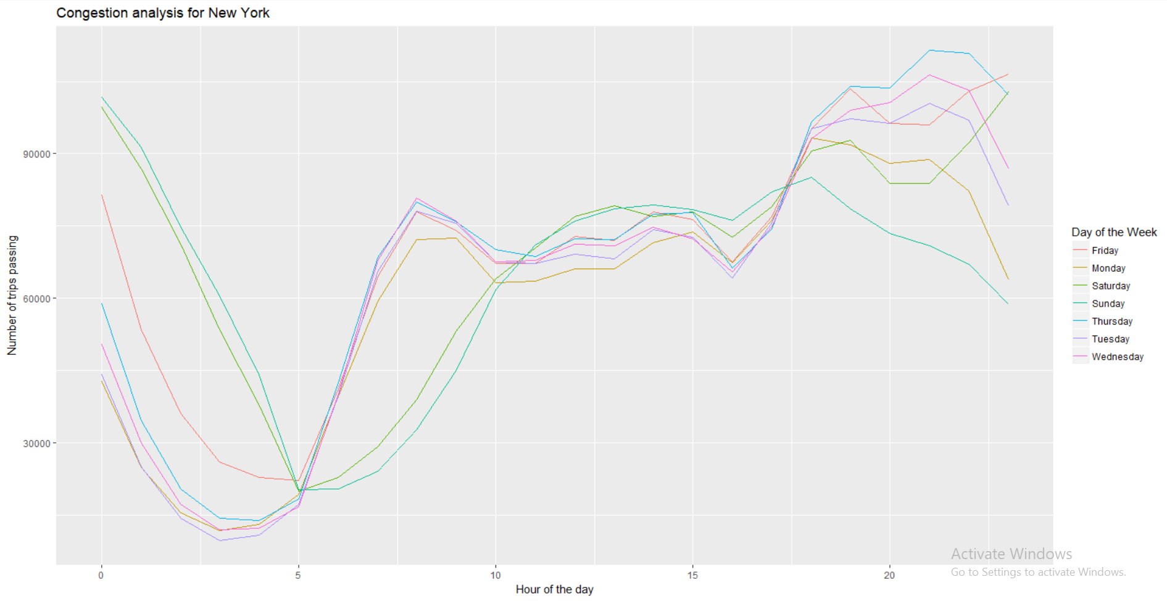
Results
Congestion analysis of New York

Slide 12
Trip duration prediction
How features are selected?
Forward selection
Correlations and relationships
Common sense!
Features
- Which vendor - Day of the week - Month - Is weekend? - Hour of the day - Distance - Transformed location
Distance
- Calculated using harvesine distance between 2 longitude and latitude points.
Machine learning models
Linear Regression
Random forest
XGBoost

Slide 13

Challenges
Principle component analysis (PCA)
Geographical data
Log10
Normally distributed

Slide 14
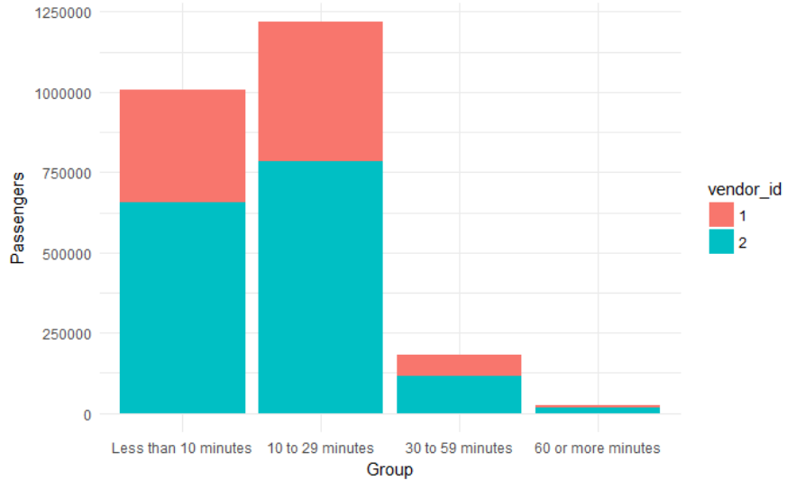
Insights
Data talks!

Slide 15
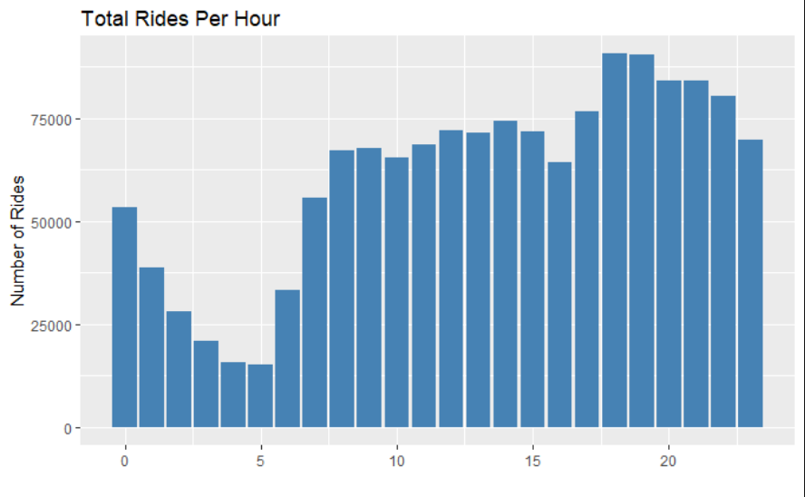
Insights
Data talks!

Slide 16
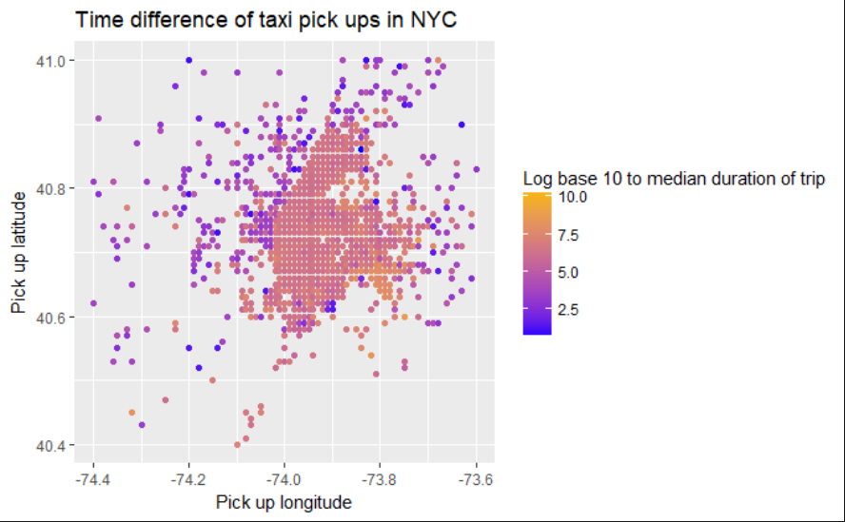
Insights
Data talks!

Slide 17
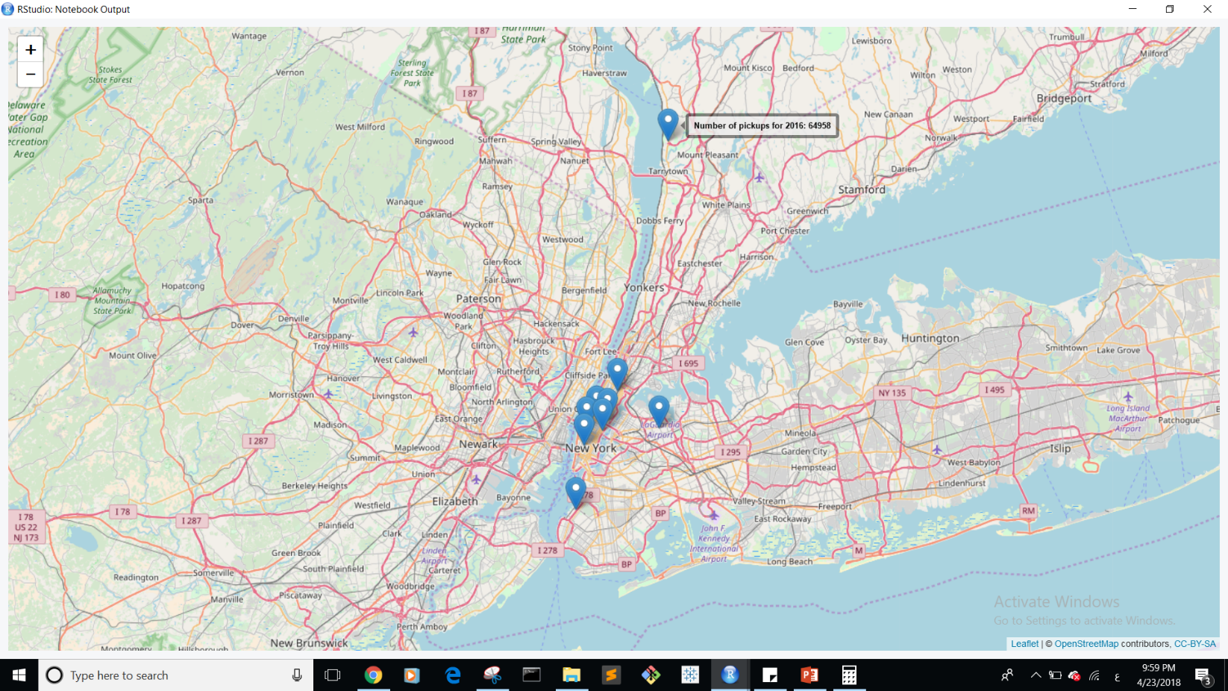
Insights
Where is the peak point of pickups?

Slide 18
Results
“My model is working, this time I know why!”
Linear Regression
R-squared: 0.65
RMSE: 2.7
XGBoost
R-squared: 0.76
RMSE: 2.3
- When it comes to business, explainable models always wins!

Slide 19
Accidents scoring model

Slide 20

1
How many accident occur in this location?
Number of accidents score
No risk (1) : 1~4 Low risk (2) : 5~11 Medium risk (3) : 12~24 high risk (4) : More than 25

Slide 21

2
How many person
got injured?
Number of injured persons score
No risk (1) : 0 Low risk (2) : 1 Medium risk (3): 2~5 High risk (4): More than 5

Slide 22

3
Time interval of those accidents
Time score
No risk (1) : More than 15 weeks or 1 accident Low risk (2) : Less than 15 week Medium risk (3) : Less than 1 week high risk (4) : Less than 1 day

Slide 23

0.5* Time score + 0.3*Number of injured persons score + 0.2*Number of accidents score
Scoring
3.4
1.0

Slide 24
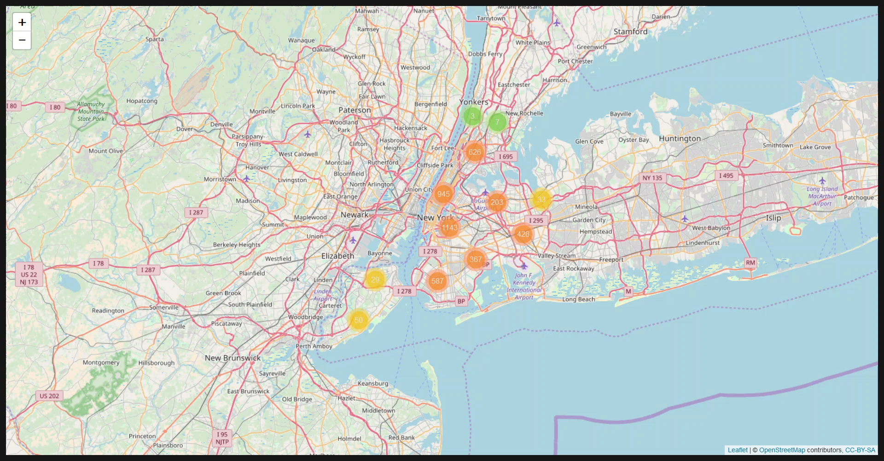

Slide 25

Future work
Improving scoring model
Fastest-safest routes recommending
Improve prediction accuracy

Slide 26
In God we trust, all others must bring data.
—W. Edwards Deming

Slide 27

Thank You!

